Slide 1


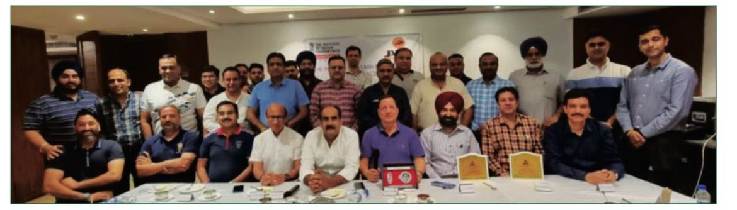
April-2023
Health and Wellness
IIF-Chandigarh Chapter in association with Jalandhar Auto Parts Manufacturers Association (JAMA) organised an awareness programme on Health and Wellness on April 12, 2023 at Hotel Ramada

Slide 2
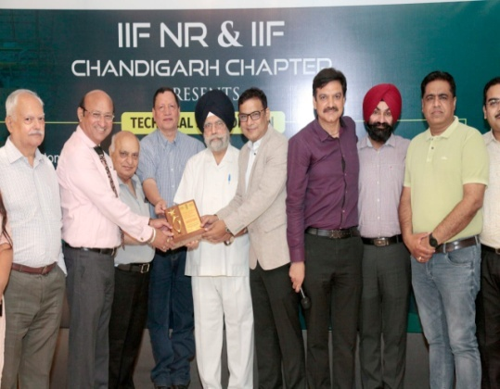
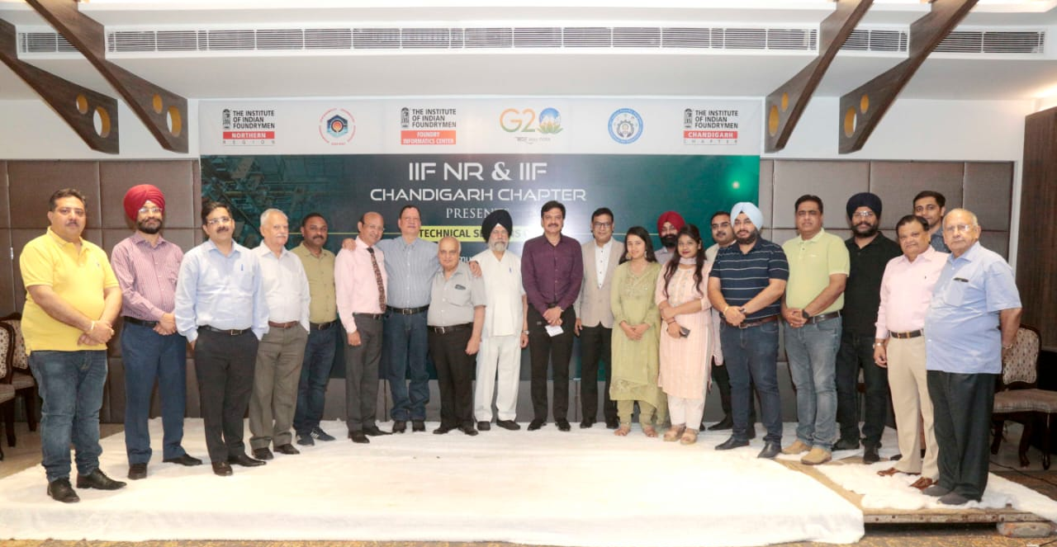
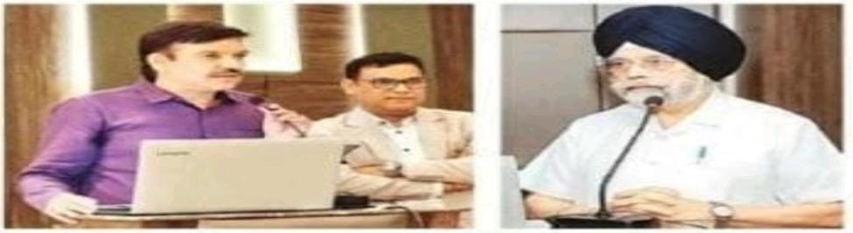
May - 2023
2. IIF NR and IIF Chandigarh Chapter conducted an awareness program on Low cost Automation, how to reduce casting defects and SIDBI Schemes for MSMEs on 26th May 2023 at Jalandhar.

Slide 3
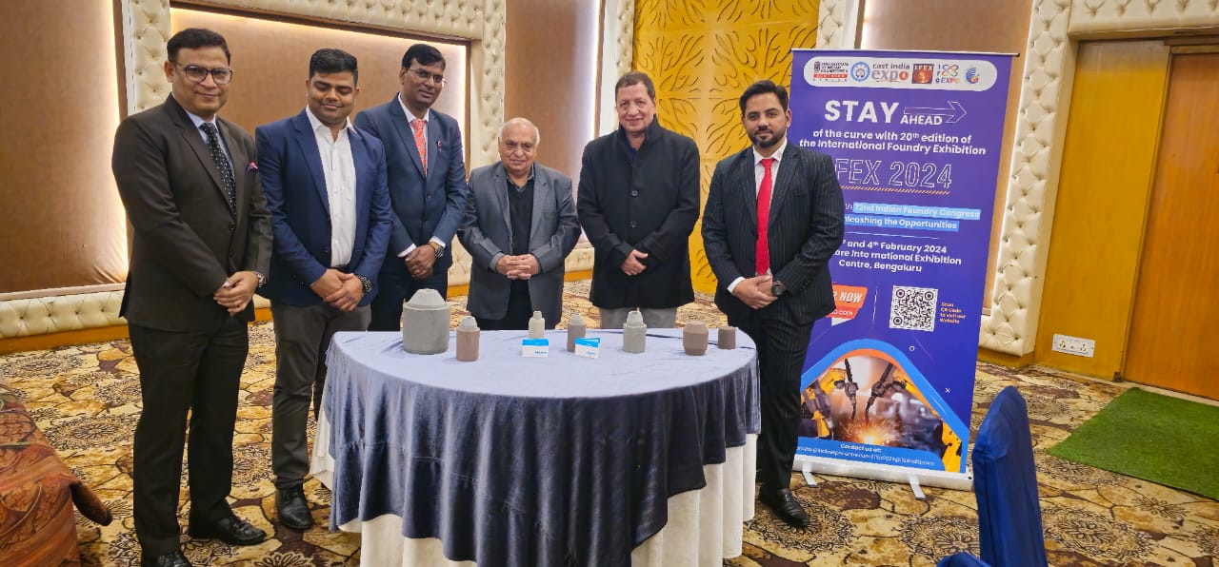
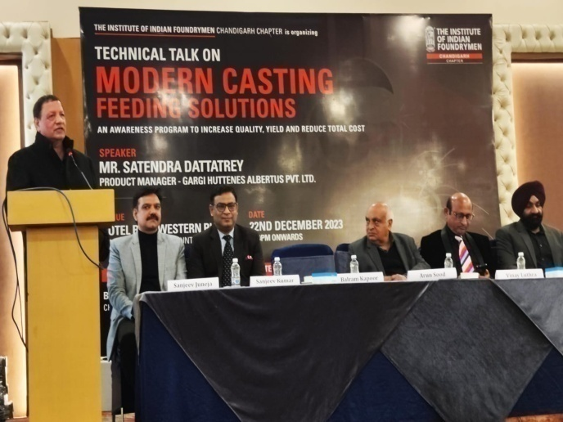
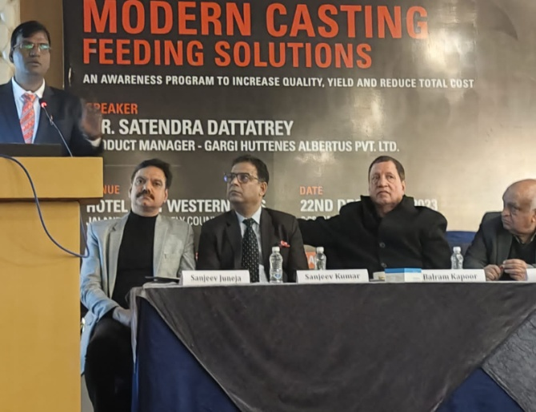
December-2023
18. Chandigarh Chapter of The Institute of Indian Foundrymen conducted a technical awareness program on Modern Casting Feeding Solutions on Arun Sood, Chairman Kumar Autocast Ltd. Ludhiana was the Chief Guest

Slide 4
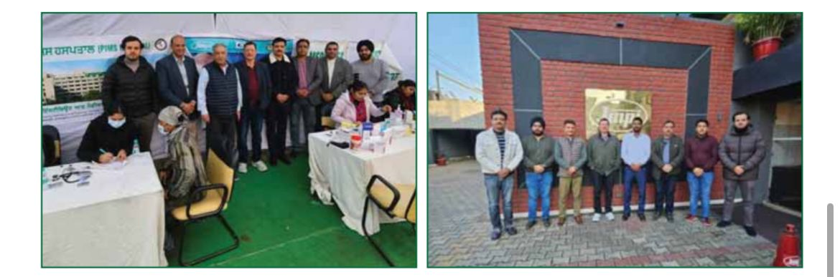
Medical Camp for Health Checkup
A medical camp was organised recently by IIF-Chandigarh Chapter in association with CII Zonal Office, Jalandhar and Punjab Institute of Medical Sciences (PIMS) at JMP Industries, Jalandhar wherein health check-up of more than 200 employees of the company was done at free of cost and medicines were also distributed among them.

Slide 5
Representations to
Government Departments

Slide 6
1.Representation was given to Sh. Jyotiraditya Scindia, Honorable Minister of Civil Aviation, Govt. of India by our Chairman Sh. Balram Kapoor requesting him to restart flight from Jalandhar to Delhi and return. This flight route was closed during Corona period. Mr. Scindia assured that this flight will be started at the earliest possible
2. Representation was handed over to Sh. Santokh Singh Chaudhary, Member of Parliament, Jalandhar, Punjab requesting for Govt. of India intervention for restricting exports and reducing duties on import of Iron and Steel. The action was taken by centeral govt. and export of iron and steel was restricted temporarily to give relief to domestic industry.

Slide 7
3.Delegation went to meet Dr. Sarabjit Singh, Principal Director Central Institute of hand tools requesting him to utilize funds received by them to buy machinery required by foundry industry. This meeting was also fruitful and Dr. Sarabjit bought machinery on our recommendation.
4.In addition to this representations were given to various depts.. to help and support industry. Last year during paddy season and peal load demand delegation went to Patiala to meet Director Distribution and Director Generation PSPCL requesting them for equitable supply and load shedding in all cities of Punjab.

Slide 8
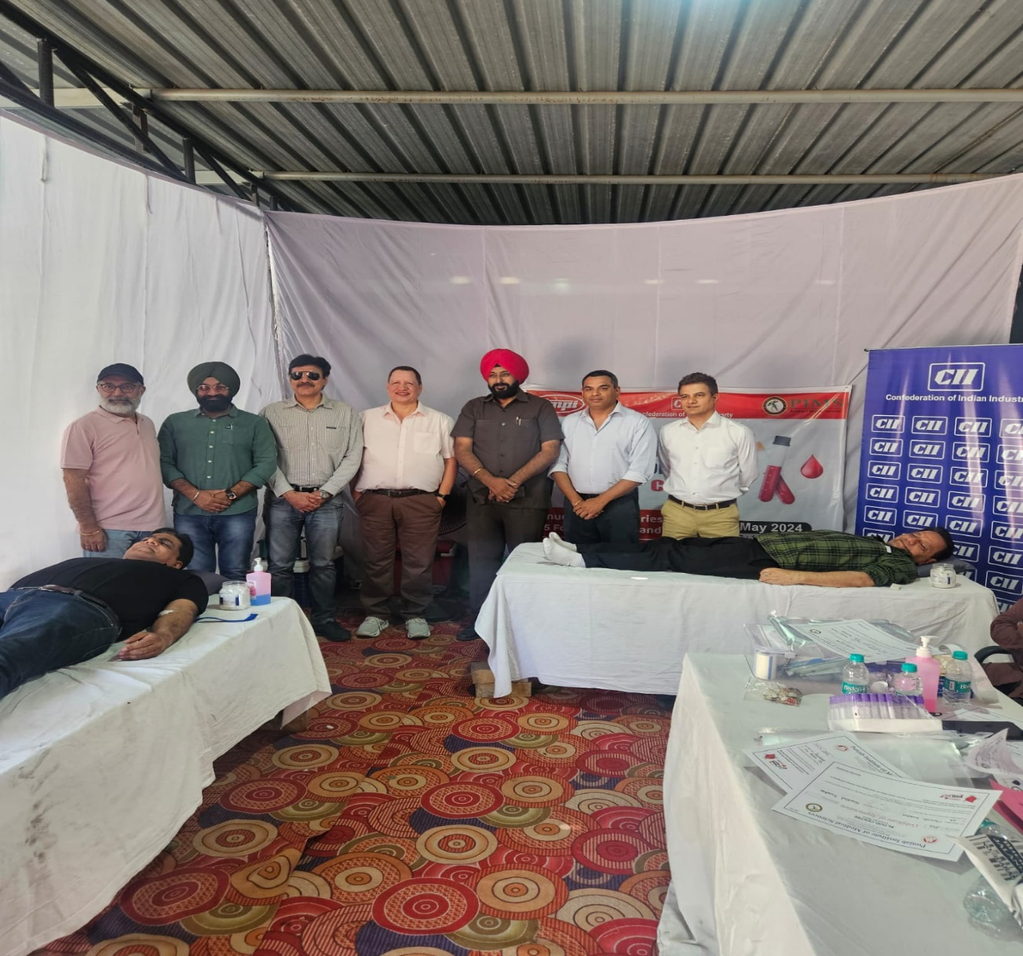
MEDICAL HEALTH CHECK UP AND BLOOD DONATION
1st May 2024 at Jalandhar
IIF Chandigarh Chapter in partnership with Confederation of Indian Industries
(CII), Zonal Office, Jalandhar and Punjab Institute of Medical Sciences (PIMS)
organized a Medical Health Check up and Blood Donation Camp on 1st May 2024
at JMP Industries, Jalandhar.

